Slide 1

Automatic Measurement System for Cargo Volume
Sponsor: Panasonic Mentor: Zhuosi Zhang Instructor: Mingjian Li
Presented by Group 17

Slide 2


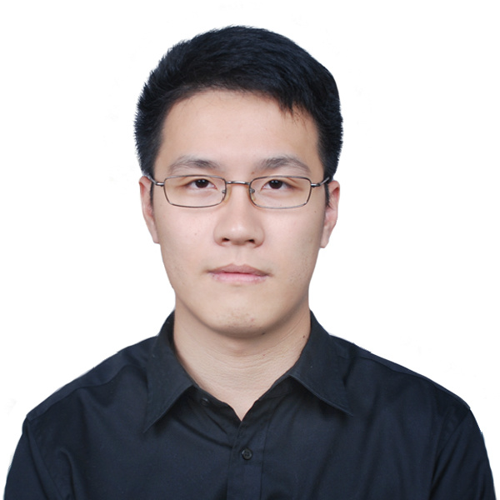


Team Introduction
Team Members:
Zesen Wang (Leader)
JI ECE + KTH ML
Xinyi Wu
JI ECE + UM DS
Yier Zhang
JI ECE + UM EE
Yetong Zhang
JI ME + UM CE
Zitao Zhang
JI ECE + KTH ML

Slide 3
Customer Requirements
Motivation: Quickly growing demand of cargo delivery in China. Demand on
Fast packing and loading process
Efficient usage of vehicle capacity
Accurate freight calculation

Slide 4
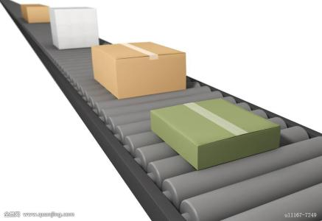
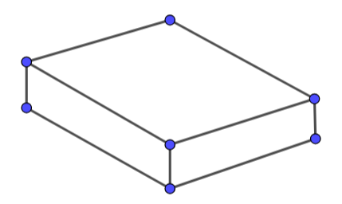
Customer Requirements
Projective:
Accurate measurement of the volume of goods on a conveyor belt
Automatic running
Standardized measurement process
Easy to build, install and use
Low-cost
Expected outcome:
Volume of the goods
3-D model map of the goods
Image Referenece: https://ss0.bdstatic.com/70cFuHSh_Q1YnxGkpoWK1HF6hhy/it/u=3831402330,1049417822&fm=200&gp=0.jpg

Slide 5
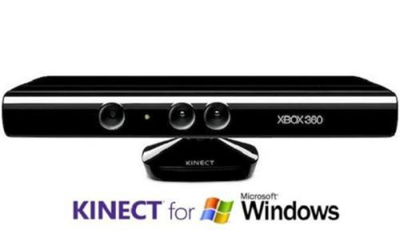
Literature Search and Benchmark
Measurement Methods with Kinect
KinectFusion Algorithm
Merging different views of an object
Measurement Methods without Kinect
Optical system for detecting three-dimensional shape
Video-based shape detection apparatus
Autofocusing and image detection at each focus level
Notes:
After some literature searches, we find out that the kinect is popular in the area of 3d model construction. We find some methods working with kinect and without kinect

Slide 6
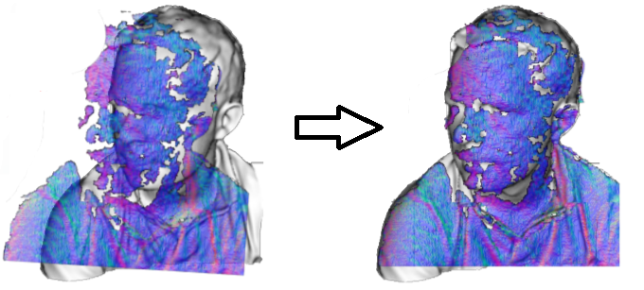
KinectFusion Algorithm
Main idea: Reconstruct a 3D scene in real-time by moving the Kinect camera around the real scene. Use Iterative Closest Point (ICP) to align and combine the scenes.
Drawbacks:
Heavy computation (20 fps, GTX480 and 4GB of RAM)
Does not filter out background
Image Reference: Newcombe, Richard A., et al. "KinectFusion: Real-time dense surface mapping and tracking." Mixed and augmented reality (ISMAR), 2011 10th IEEE international symposium on. IEEE, 2011.

Slide 7
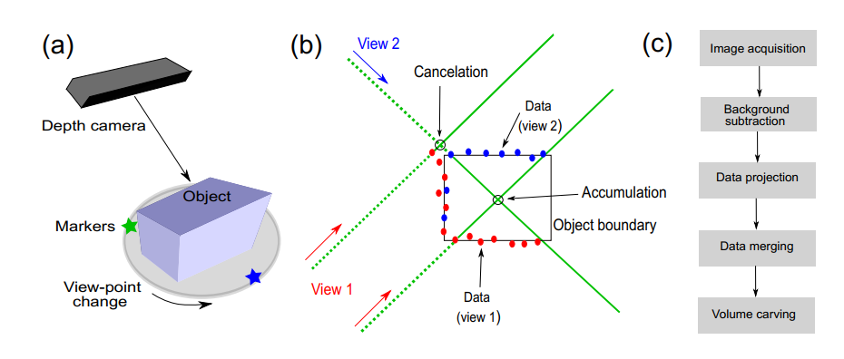
Depth Camera in Volume Measuring
Dellen, Babette, I. Rojas, “Volume measurement with a consumer depth camera based on
structured infrared light”, 16th Catalan Conference on Artificial Intelligence, poster session, 2013, Vic, Spain, pp. 1-10, ACIA.
Notes:
Here is another case. It uses depth camera in volume measuring. The object is placed on the rotating platform.

Slide 8
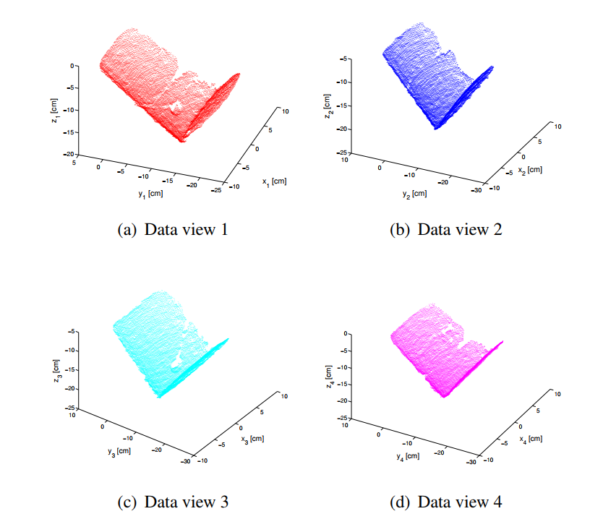
Dellen, Babette, I. Rojas, “Volume measurement with a consumer depth camera based on
structured infrared light”, 16th Catalan Conference on Artificial Intelligence, poster session, 2013, Vic, Spain, pp. 1-10, ACIA.
Notes:
The views from different perspectives are captured

Slide 9
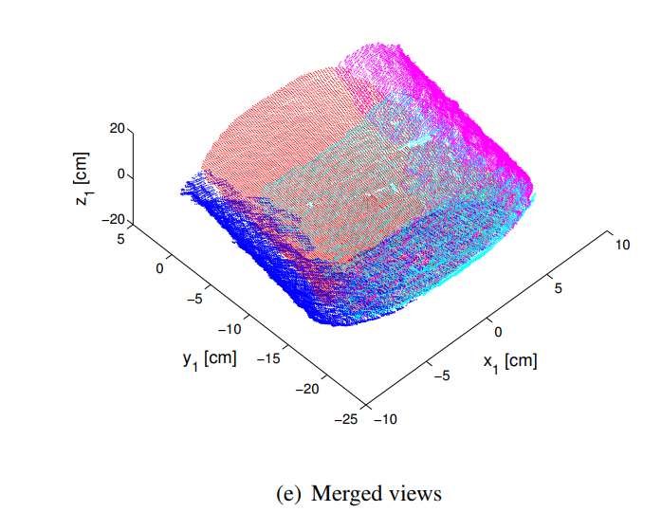
Dellen, Babette, I. Rojas, “Volume measurement with a consumer depth camera based on
structured infrared light”, 16th Catalan Conference on Artificial Intelligence, poster session, 2013, Vic, Spain, pp. 1-10, ACIA.
Notes:
Then the algorithm will concatenate the views, and a 3-D model is obtained.

Slide 10
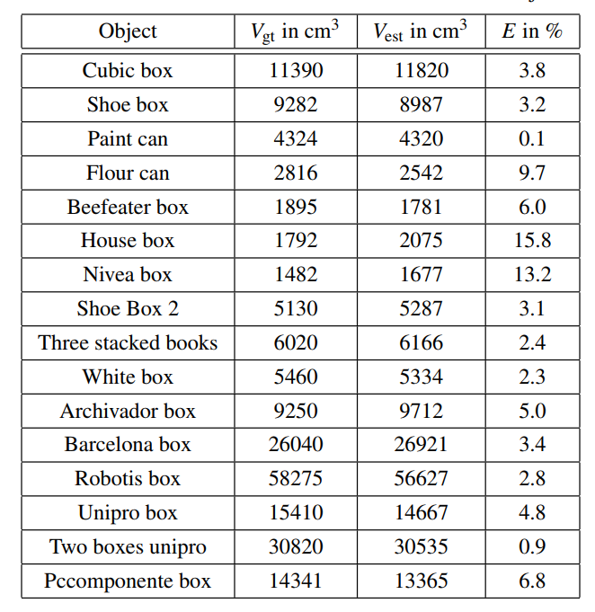
Ground Truth VS Estimated Value
Dellen, Babette, I. Rojas, “Volume measurement with a consumer depth camera based on
structured infrared light”, 16th Catalan Conference on Artificial Intelligence, poster session, 2013, Vic, Spain, pp. 1-10, ACIA.

Slide 11
Measurement Methods
Without Kinect
Optical system for detecting three-dimensional shape
Move a beam of light over the object
Fail to deal with moving cargoes
Video-based shape detection apparatus (Panasonic)
Take consecutive images at a high frequency
Work with conveyor belts
Lack efficiency
Autofocusing and image detection at each focus level
A naive version of depth camera
Fail to deal with moving cargoes
Lack efficiency
Kakinoki, Yoshikazu, Masato Nakashima, Tetsuo Koezuka, Noriyuki Hiraoka, Hiroyuki Tsukahara, Yoshinori Suto, Yoshitaka Oshima, and Shinji Hashinami. Optical System for Detecting Three-dimensional Shape. Fujitsu Ltd, assignee. Patent US5004929A. 2 Apr. 1991. Print.
Itsuzaki, YasuoYoshihiro, Masatoshi Nakamura, Noriyuki Suzuki, Misuzu Takano, and Kinji Horikami. Shape Detection Apparatus. Panasonic Corp, assignee. Patent US5995663A. 30 Nov. 1999. Print.
Nakagawa, Yasuo, and Shree Nayer. Method of Detecting Solid Shape of Object with Autofocusing and Image Detection at Each Focus Level. Hitachi Ltd, assignee. Patent US5151609A. 29 Sept. 1992. Print.

Slide 12
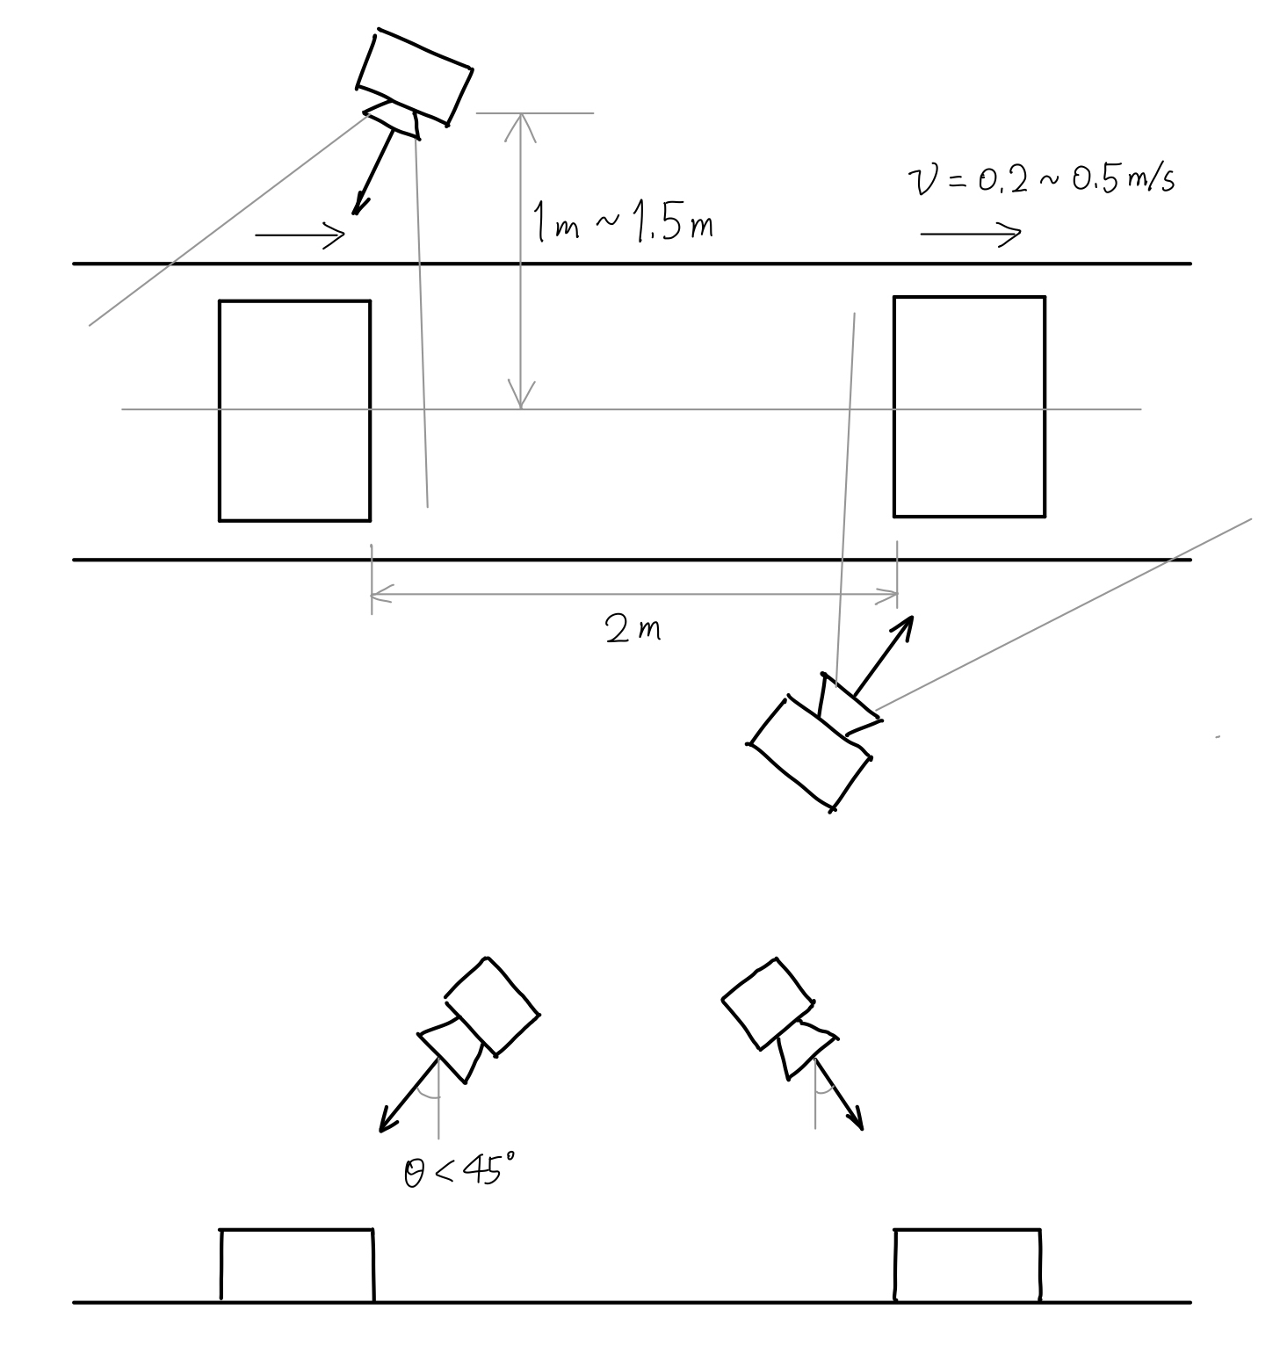
Draft Solution
Top view
Side view

Slide 13
Customer Requirements and Engineering Specifications
Customer requirements:
High efficiency
Save manpower
Low cost
Standardize the measurement process
Easy to build and install
Easy to use
High accuracy
Different cargo size capacity
Special-shape cargo measurement
Visualization output
Engineering Specifications:
Speed of conveyor belt
Cargo size range
Processing time
Number of depth cameras
Filming angle range
Camera distance
Max unilateral error
Cost restriction

Slide 14
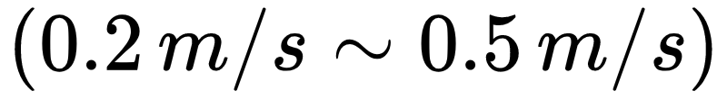
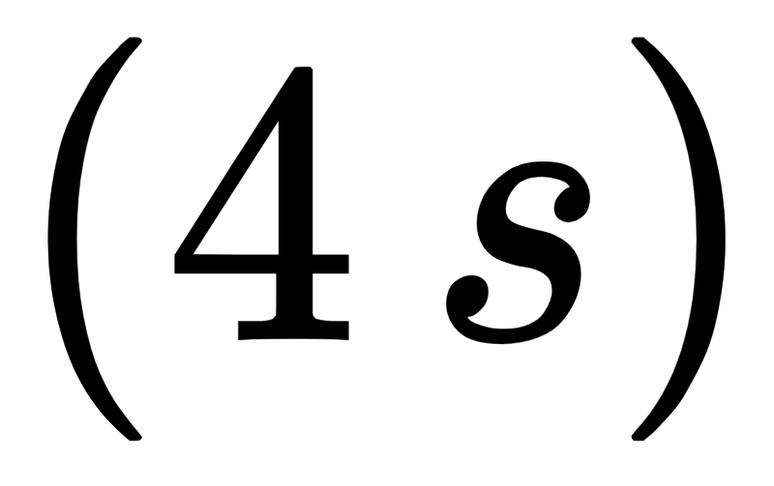
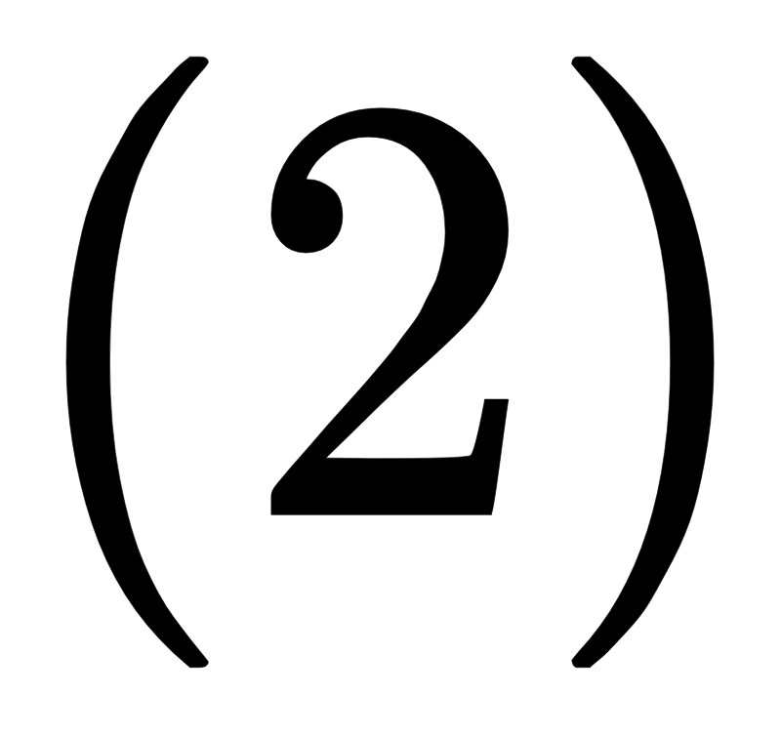
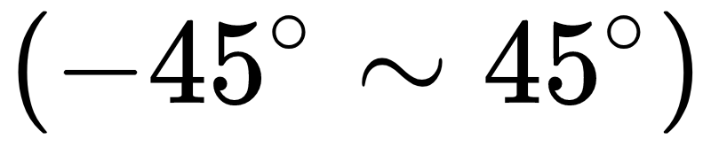
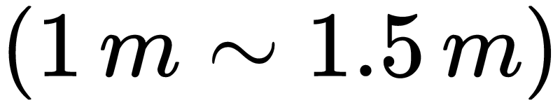
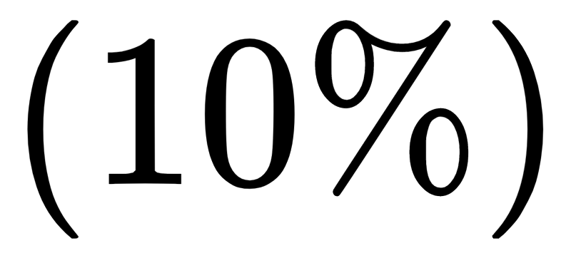
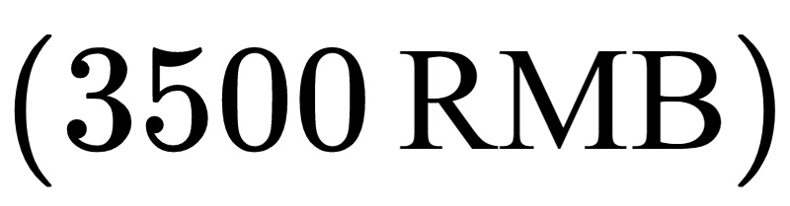
Quantification of ES
Background
Speed of conveyor belt
Cargo size range
Processing time
Design Detail
Number of depth cameras
Filming angle range
Camera distance
Technical Objective
Max unilateral error
Cost restriction

Slide 15
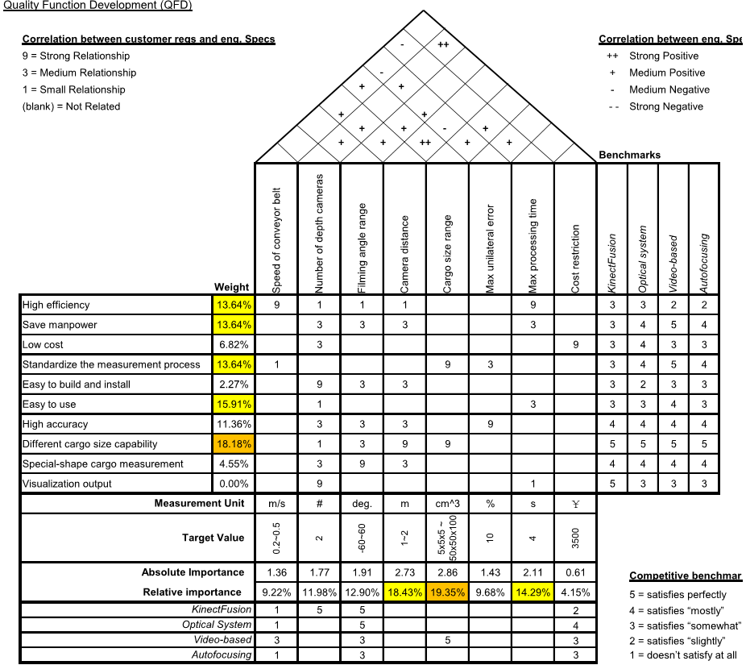
Quality Function Development
-45~45
1~1.5

Slide 16
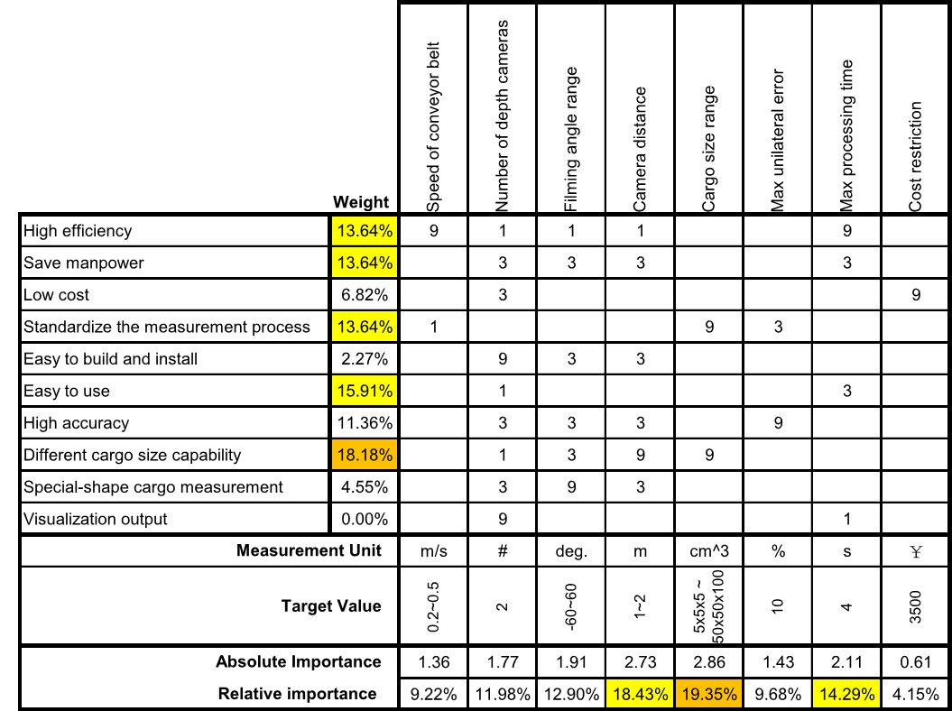
Quality Function Development
-45~45
1~1.5

Slide 17
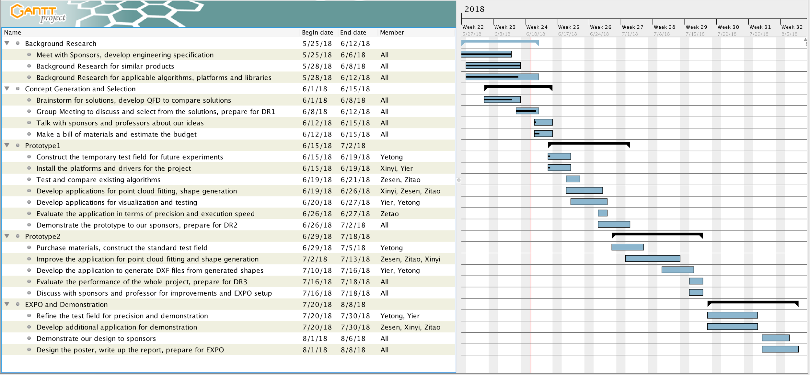
Project Schedule

Slide 18
Reference
[1] Newcombe, Richard A., et al. "KinectFusion: Real-time dense surface mapping and tracking." Mixed and augmented reality (ISMAR), 2011 10th IEEE international symposium on. IEEE, 2011.
[2] J. Loera, J. Rambau and F. Santos (2010), Triangulations: Structures and Algorithms (2nd revised ed.), Springer-Verlag, ISBN 9783642129711 Chapter 3: Polygon Triangulation: pp.103.
[3] Besl, Paul J.; N.D. McKay (1992). "A Method for Registration of 3-D Shapes". IEEE Trans. on Pattern Analysis and Machine Intelligence. Los Alamitos, CA, USA: IEEE Computer Society. 14 (2): 239–256. doi:10.1109/34.121791
[4] Pirovano, Michele. "Kinfu–an open source implementation of Kinect Fusion+ case study: implementing a 3D scanner with PCL." no. October 2012 (2011).
[5] Kakinoki, Yoshikazu, Masato Nakashima, Tetsuo Koezuka, Noriyuki Hiraoka, Hiroyuki Tsukahara, Yoshinori Suto, Yoshitaka Oshima, and Shinji Hashinami. Optical System for Detecting Three-dimensional Shape. Fujitsu Ltd, assignee. Patent US5004929A. 2 Apr. 1991. Print.
[6] Itsuzaki, YasuoYoshihiro, Masatoshi Nakamura, Noriyuki Suzuki, Misuzu Takano, and Kinji Horikami. Shape Detection Apparatus. Panasonic Corp, assignee. Patent US5995663A. 30 Nov. 1999. Print.
[7] Nakagawa, Yasuo, and Shree Nayer. Method of Detecting Solid Shape of Object with Autofocusing and Image Detection at Each Focus Level. Hitachi Ltd, assignee. Patent US5151609A. 29 Sept. 1992. Print.
[8]. Specification for “Heavy Duty Slider Bed Conveyor - Model TL 42" OAW, 17'-1" long”,
Hytrol Conveyor Company, Inc. http://www.cisco-eagle.com/catalog/product/12410/
heavy-duty- slider-bed-conveyor-model-tl-42-oaw-17-1-long
[9]. “Kinect for Windows Sensor Components and Specifications” https://msdn.microsoft.com/en-us/library/jj131033.aspx
[10]. K. Khoshelham, S.O. Elberink, “Accuracy and resolution of Kinect depth data for indoor mapping applications”, Sensors, 12:1437–1454, 2012.
[11]. Li, Lingling, Z. Wang, L. Qing, and H. He, “Fast Volume measurement based on Kinect 2.0 depth image”, Microcomputer & Its Applications, vol. 1, no. 7, 2017, pp. 35-38.
[12]. Dellen, Babette, I. Rojas, “Volume measurement with a consumer depth camera based on
structured infrared light”, 16th Catalan Conference on Artificial Intelligence, poster session, 2013, Vic, Spain, pp. 1-10, ACIA.

Slide 19
Presented by Group 17

Slide 20
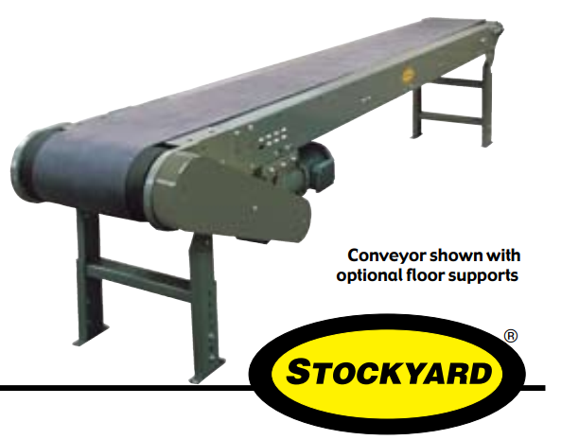
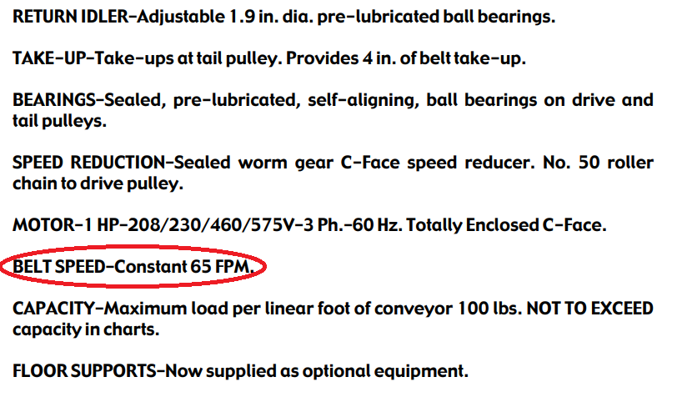
Speed of Conveyor Belt
Heavy Duty Slider Bed Conveyor - Model TL 42" OAW, 17'-1" long
=0.33m/s

Slide 21
Processing Time
2 meters space between two goods
0.5 m/s maximum speed
T_min = 2 / 0.5 = 4s

Slide 22
Cost Restriction
Kinect 2.0 x 2 1488 * 2 = 2976RMB
Camera Support x 2 30 * 2 = 60RMB
Light Reflection Tape 10RMB/m * 20 m = 200RMB

Slide 23
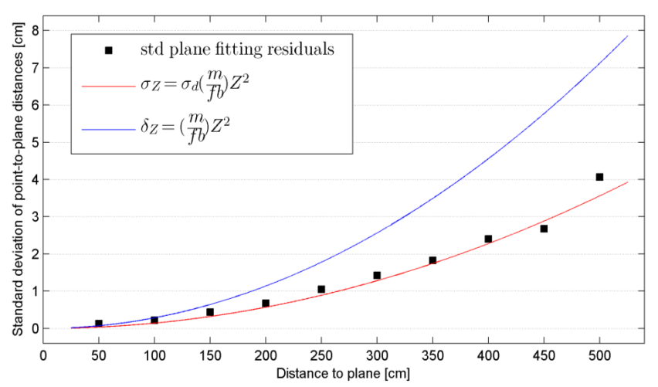
Max Unilateral Error
errors increase quadratically with camera distance
About 0.5 cm deviation at 1.5 m distance
Max unilateral error = 0.5cm/5cm = 10%
“Kinect for Windows Sensor Components and Specifications” https://msdn.microsoft.com/en-us/library/jj131033.aspx

